Slide 1
CSDI Paper Presentation
Xiao Yuwei
118037910061
3.22.2019

Slide 2
Scalable Read-mostly Synchronization Using Passive Reader-Writer Locks
Ran Liu, Heng Zhang, Haibo Chen
IPADS, 2014 USENIX
Notes:
这篇文章的主要工作是设计实现了 PRWLocks
以支持 read most 场景下，高性能和高扩展性的 synchronization
首先来看一下 RWLock 是什么样子

Slide 3
Traditional RWLock
Reader Lock
Reader Unlock
Writer Lock
lock mutex_r
reader_count += 1
If reader_counter = 1
lock mutex_g
unlock mutex_r
lock mutex_r
reader_count -= 1
If reader_counter = 0
unlock mutex_g
unlock mutex_r
lock mutex_g
Writer Unlock
unlock mutex_g
mutex_r
Synchronization between readers
Synchronization between writer and readers
reader_count
mutex_g
Notes:
RWLock 的语义比 mutex 稍弱一点。虽然只允许同一时刻只能有一个写，但允许多个read操作同时进行。
最简单的 RWLock 实现可以用两个 mutex 实现。
Reader 部分看起来相对复杂一点，但逻辑也很简单。
在 RWLock 的语义下，读操作其实并不需要时时刻刻去同步。这就引出了本篇文章第一个 motivation.

Slide 4
Motivation
Poor scalability
Evolution
Law of order: Expensive synchronization in concurrent algorithms cannot be eliminated, 2011 PPoPP
Exclusive
Lock
MCS, etc
HTM
Impossible
Semantic Guarantee
Traditional
RWLock
Big Reader Lock
PRWLock
RCU
Scalability Performance
Notes:
今天要介绍的PRWLock在图上的位置大概在这里，xxxx
所以这边文章的 contribution 就是

Slide 5
Contributions
PRWLock
Read-most synchronization on TSO architectures
Good scalability
Parallel wakeup mechanism
……
Easy implementation
Only 300 LoC (Line of Code), 30 LoC manual change

Slide 6
Mechanism - PASSIVE RW Lock
Notes:
为了更好的理解 Passtive 的含义，我们首先看一下和他相反的 ACTIVE Lock 是什么样子的

Slide 7
ACTIVE lock
Shared states are consistent all the time
Synchronized actively
reader
Acquire
Critical Section
Release
writer
States query can happen at any time
Notes:
假如说我们有一个reader做xxx,xxx,xxx操作
如果这时候来了 writer
时刻准备着
对于多个 reader，

Slide 8
ACTIVE lock
Shared states are consistent all the time
Consistency are also maintained between readers
Acquire
Critical Section
Release
reader
Acquire
Critical Section
Release
Acquire
Critical Section
Release
writer
States query can happen at any time
Notes:
随着 reader 数量的增加, active lock 对 consistent 的要求所带来的性能开销是呈指数级上升的

Slide 9
PASSIVE lock
Shared states are consistent at particular time point
Writer has to wait/ask for readers’ report
reader
Acquire
Critical Section
Release
Reader report: I am not in critical section
writer
Never query directly. Only can ask/wait for states report.

Slide 10
PASSIVE lock
Shared states are consistent at particular time point
No consistency between readers
Acquire
Critical Section
Release
reader
Acquire
Critical Section
Release
Acquire
Critical Section
Release
Reader: I am not in critical section
writer
Never query directly. Only can ask/wait for states report.
Notes:
导师，爸妈

Slide 11
Algorithm Skeleton
Reader Lock
Writer Lock
While K == LOCKED
ReportOut()
K == LOCKED
WaitForReport()
Reader Unlock
Writer Unlock
ReportOut()
K == FREE
WaitForReport()
ReportOut()
Atomic_increase(version)
ForEach c in Core:
While c.local_version != version
localVersion = version
Notes:
首先来看 Reader 部分的算法
如果只有Reader，几乎没有 overhead
Writer 部分的算法
如果来了 Writer。balabalabala
仔细看还是会发现一些问题的，一般场景下，reader和Writer会在不同的core上面。万一有 Reader一直看不到 LOCKED

Slide 12
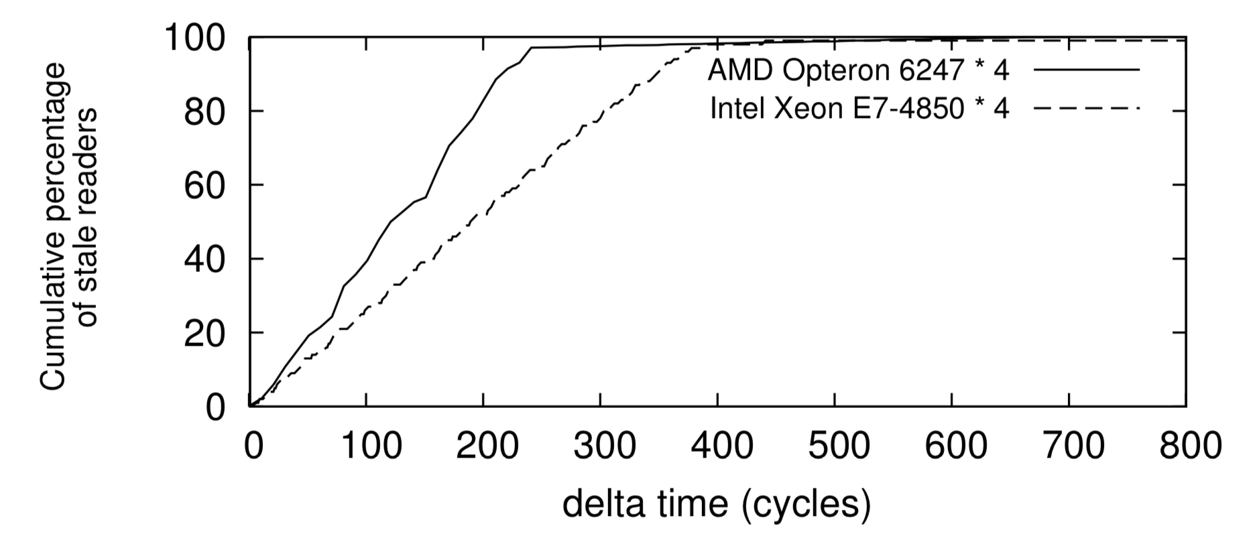
Challenges
Writer need to achieve consensus among readers
Most memory writes are visible to others within 400 cycles
Explicit synchronization is not necessary
Bounded Staleness

Slide 13
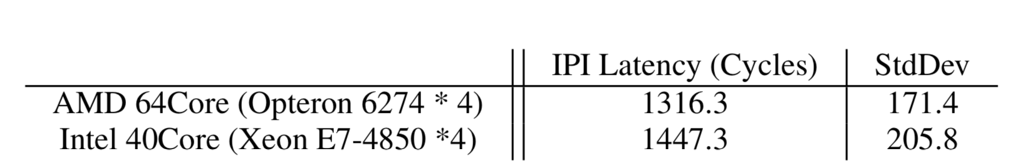
Challenges
Writer need to achieve consensus among readers – Bounded Staleness
Starvation of the writer (reader do not check explicitly)
Inter-process interrupt (IPI) latency < 1500 cycles
Cache contention overhead >= 1500 cycles
IPI is cheap
Notes:
Reader 从来没进入 critical section，永远不会 report
Writer latency, thousands of latency

Slide 14
Algorithm Skeleton - Improved
Reader Lock
Writer Lock
While K == LOCKED
ReportOut()
K == LOCKED
WaitForReport()
Reader Unlock
Writer Unlock
Send IPI
ReportOut()
K == FREE
ReportOut()
WaitForReport()
localVersion = version
Atomic_increase(version)
forEach c in Core:
While c.local_version != version
ReportHandler
ReportOut()

Slide 15
Challenges
Writer need to achieve consensus among readers – Bounded Staleness
Starvation of the writer (reader do not check explicitly) – IPI
Readers sleep while holding the locks
Uncommon condition
Lock
Unlock
PASSIVE Reader
Unlock
Sleep
Unlock
ACTIVE Reader
Wake up / Sleep
Notes:
Sleep in critical section is rare.

Slide 16
Challenges
Writer need to achieve consensus among readers – Bounded Staleness
Starvation of the writer (reader do not check explicitly) – IPI
Readers sleep while holding the locks – Count-based ACTIVE Reader
Notes:
Sleep in critical section is rare.

Slide 17
Demo
Writer Lock Acquisition
t1 write status to LOCKED
Readers report
IPI check status
Wait for reader to exit
Safe to write
Out!
P1
Reader 1
Out!
P2
Reader 2
P3
Reader 3
IPI
Out!
P4
Reader 4
Out!
t1
t2
time

Slide 18
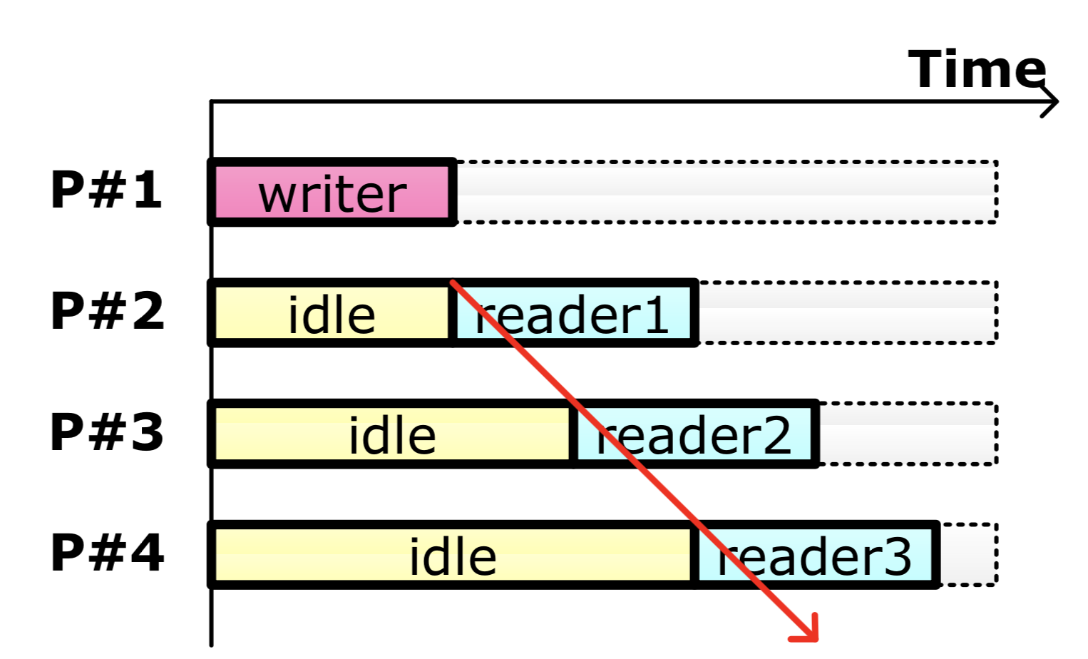
Decentralized Wakeup
Shared waiting queue
Reader 1
Reader 2
Reader 3
t1
t2
t3
Writer Finished
Waiting time grow linearly with #readers

Slide 19
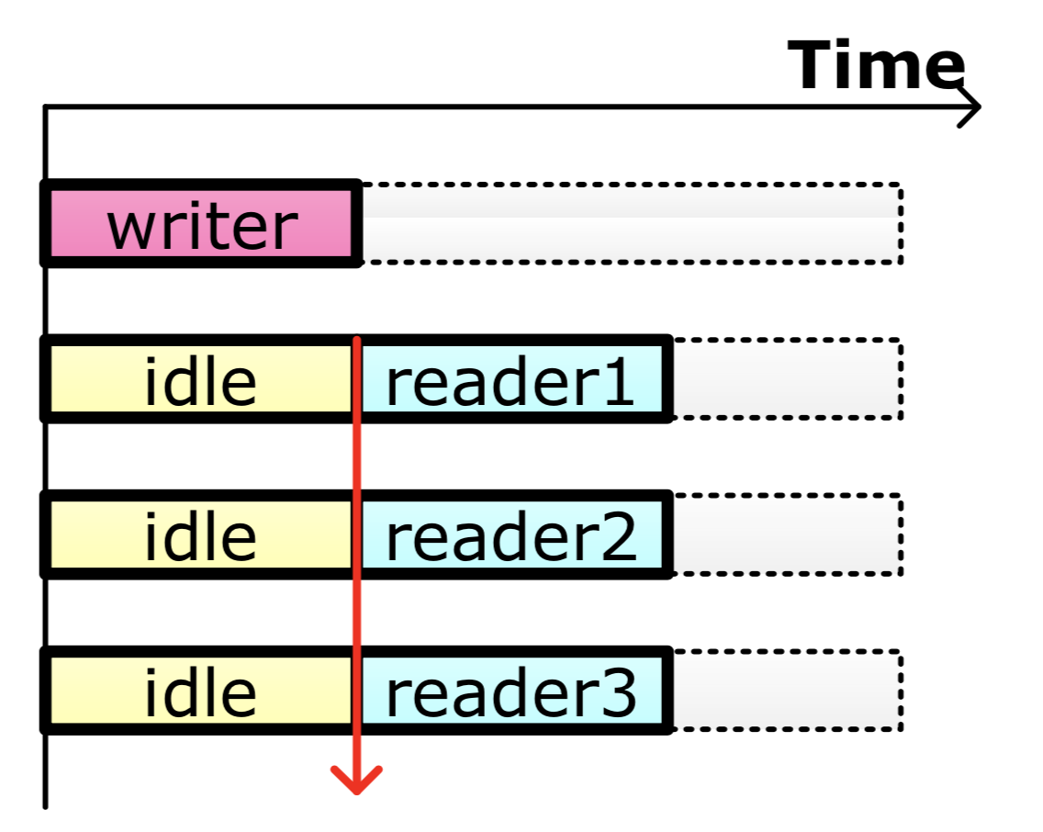
Decentralized Wakeup
Core 1 waiting queue
Reader 1
Core 2 waiting queue
Reader 2
Core 3 waiting queue
Reader 3
t1
Writer Finished

Slide 20
Evaluation
Hardware specification
64 core AMD Opteron Machine
256GB Memory
Software environment
Kernel Level: Linux 2.6.37
User Level: 3.2.6

Slide 21
Evaluation – Replace Linux mmap semaphore
Workload
Histogram : many file page fault (read)
Metis : many anonymous page fault
Psearchy : many mmap/munmap (write)
Comparison
Vanilla Linux
RCU (ASPLOS’12)

Slide 22
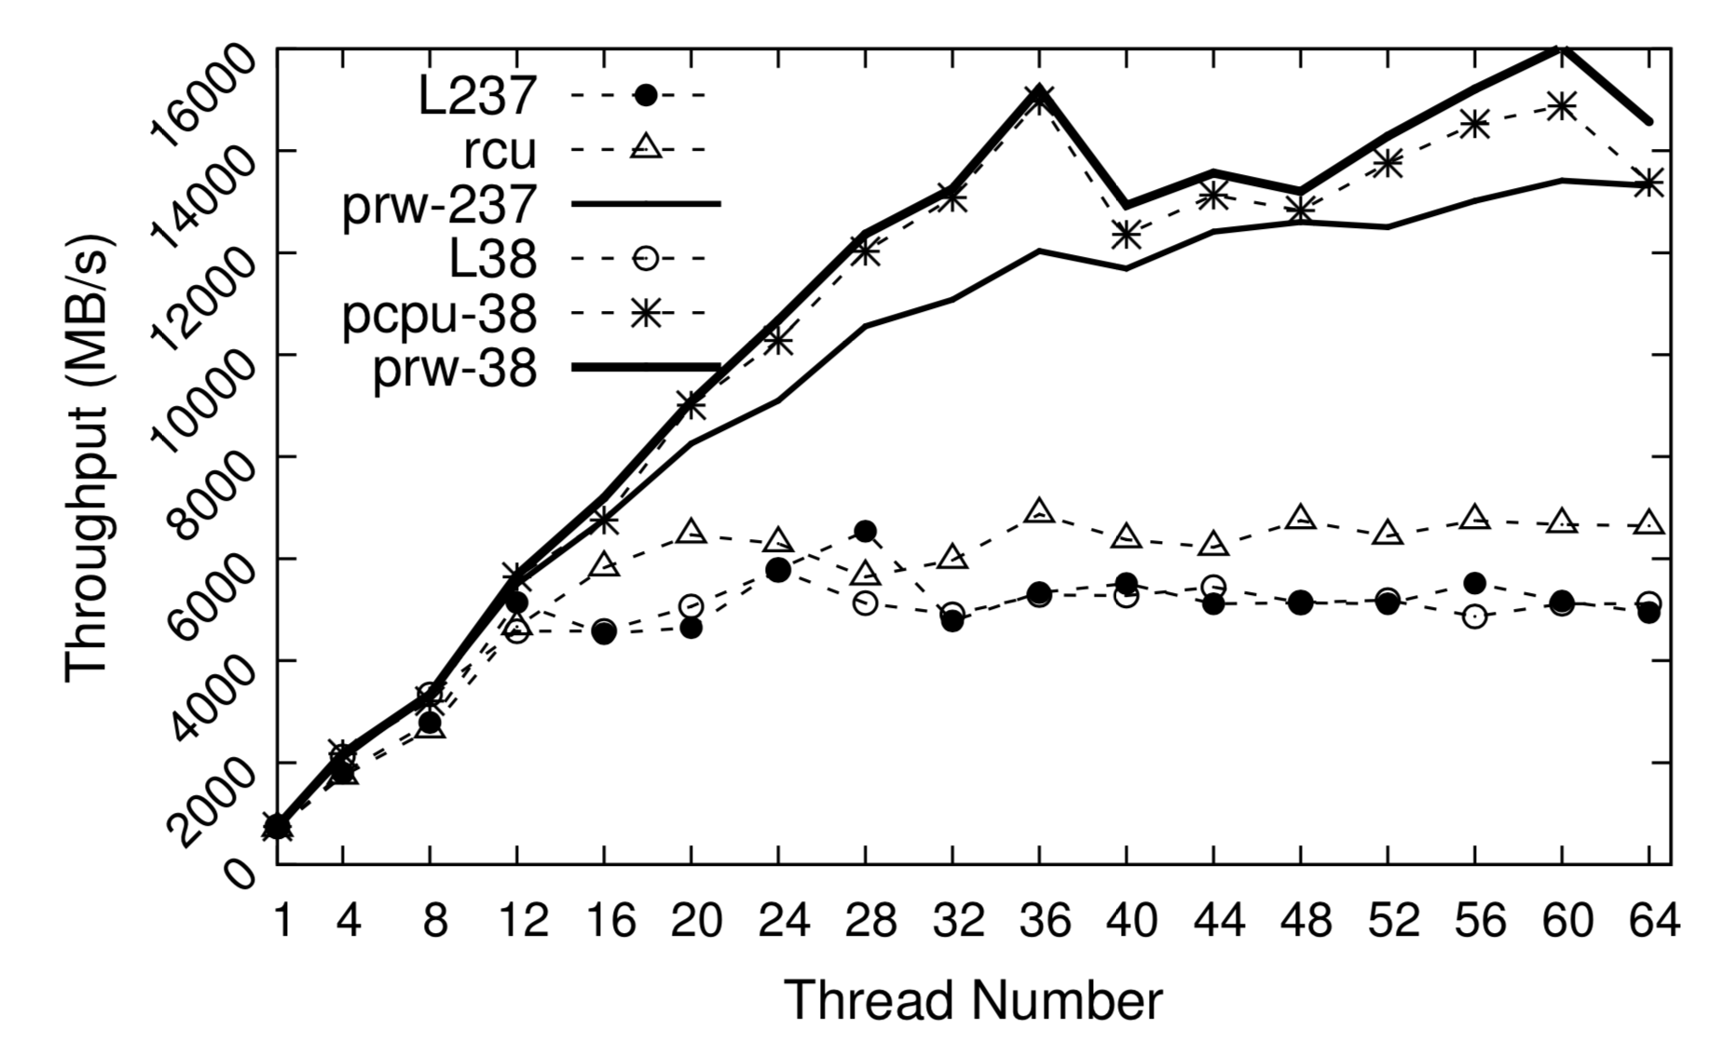
Evaluation - Histogram

Slide 23
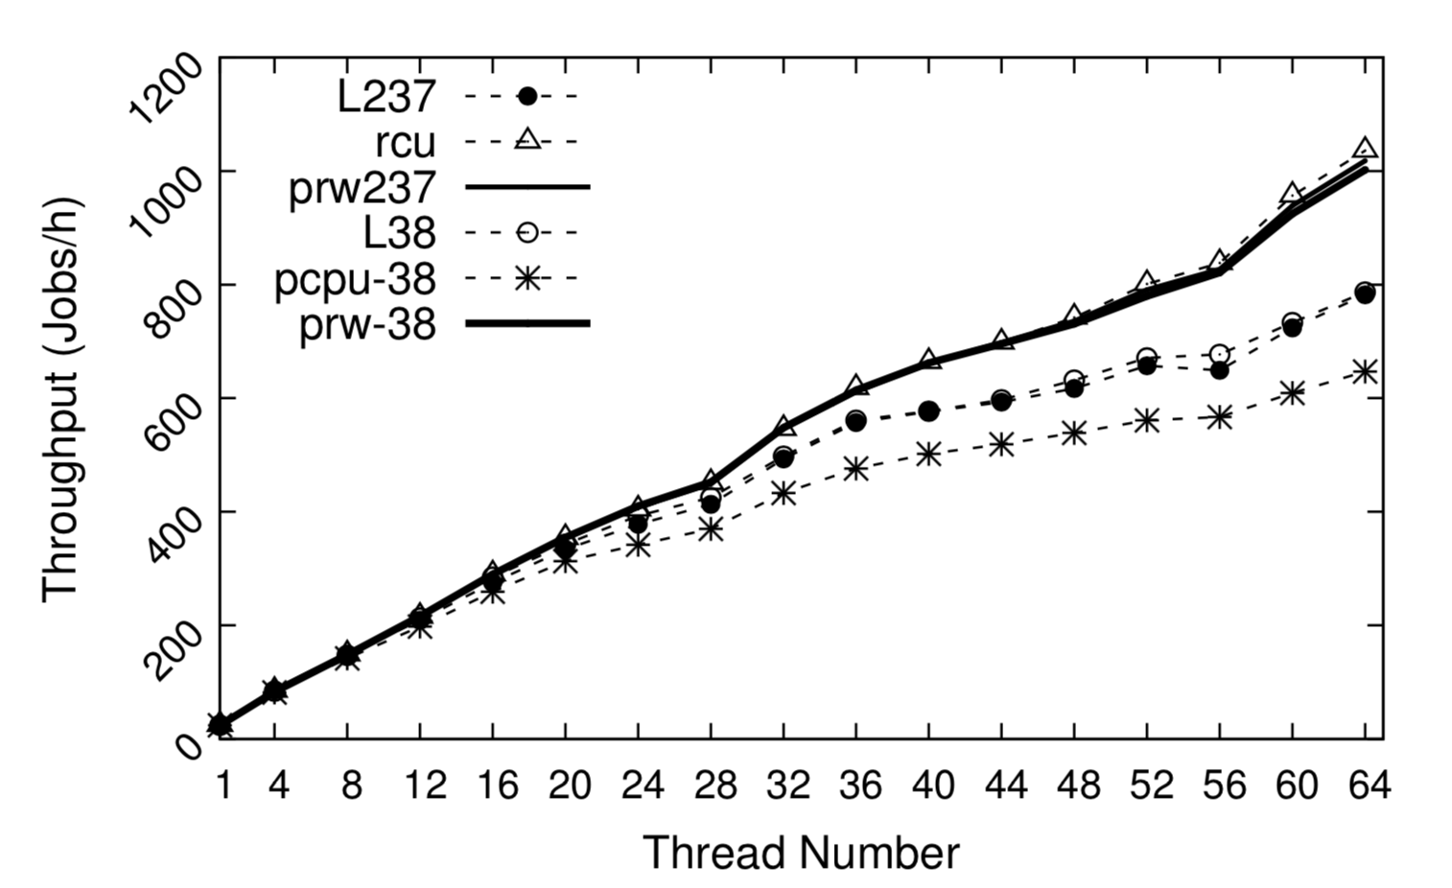
Evaluation - Metis

Slide 24
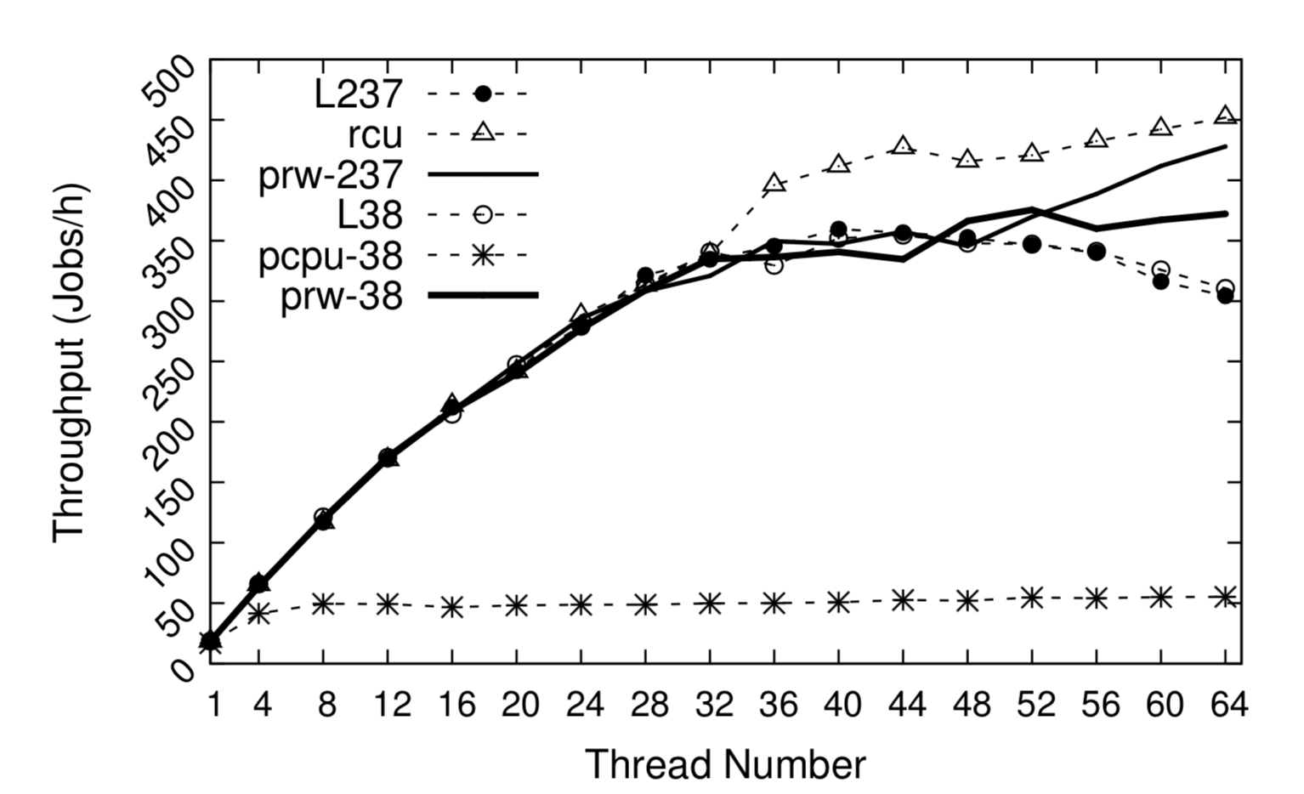
Evaluation - Psearchy
Notes:
mmap intensive scenario
RCU允许read和writer同时去做一些事情
6%性能差距，更简单的实现。

Slide 25
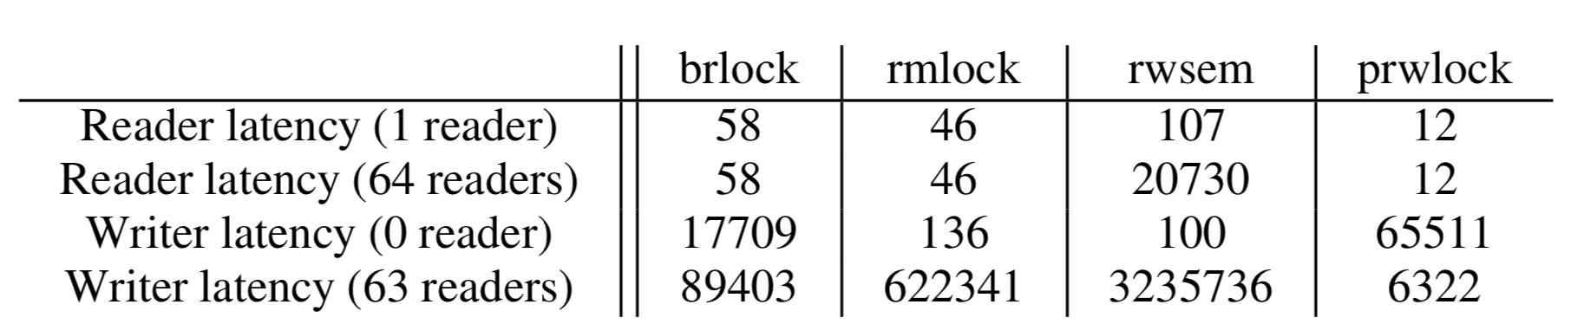
Evaluation - Microbenchmark
Raw latency
Notes:
由passive本身的属性所决定。

Slide 26

Thank you

Slide 27
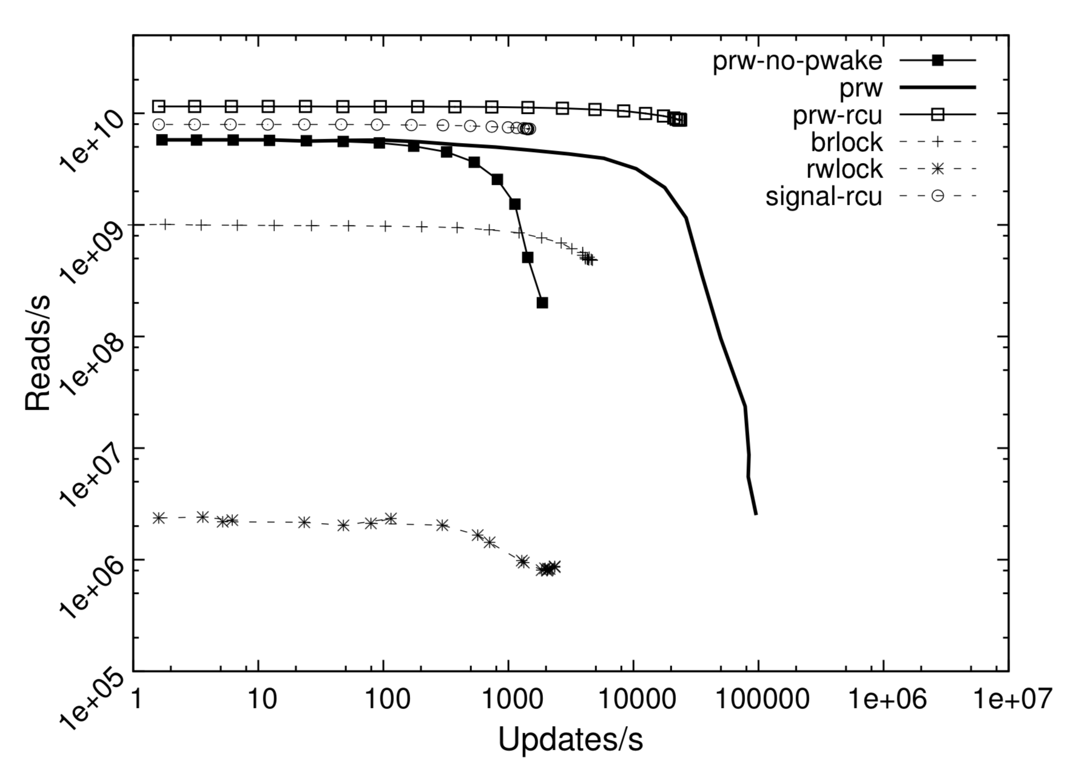
Evaluation - Microbenchmark
Reader throughput
63 readers / 1 writer

Slide 28
Correctness
Build upon TSO consistency model
Visibility guarantee
Write d
Write a
Write b
Write c
Write d
time

